Slide 1
Physical Attacks against Neural Networks
Benefits from an adversary’s viewpoint
Benoit COQUERET, Gabriel ZAID

Slide 2

Context
AI Act*, kesako ?
Creation of regulations ranging from CE marking to a marketing ban on AI systems and models placed on the market.
AI Act, who is affected?
All suppliers, developers and distributors of AI systems whose head office is in the EU or who market solutions in the EU.
AI Act, which systems are affected?
AI at unacceptable risk
High-risk AI
Low-risk AI
Minimal-risk AI
Ensure robustness, accuracy and resilience to cyber-attacks
* https://artificialintelligenceact.eu/the-act/

Slide 3
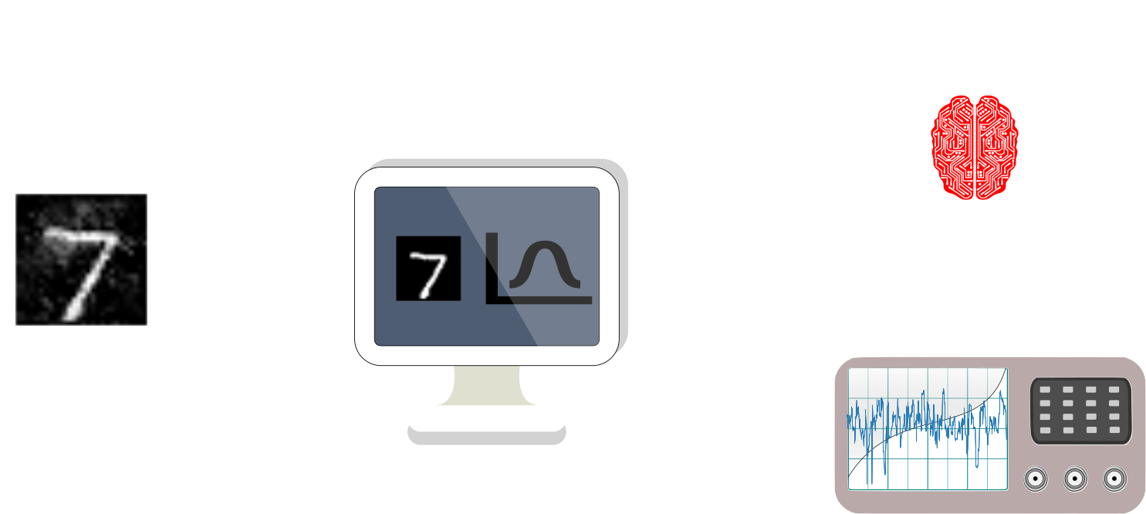

Physical Attacks against Neural Networks
(in this talk)
Evasion attacks
Fidelity-based extraction attack
‘‘When Side-Channel Attacks Break the Black-Box Property of Embedded Artificial Intelligence.’’, Coqueret et al., AISec ‘23

Slide 4




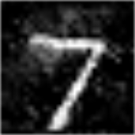
Evasion attack
It’s a 7 !
Adversarial examples, KESAKO ?
It’s a 3 !
Could be difficult to consider in practice
  White-box scenario: knowledge of the IA architecture, weights, activation functions, etc…
  Black-box scenario: partial knowledge on the AI system (e.g., logits)
Practical issue: How can we generate adversarial examples without any knowledge on the device?

Slide 5





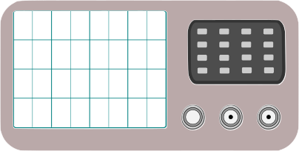
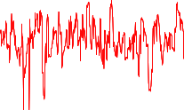

Evasion attack
Practical issue: How can we generate adversarial examples without any knowledge on the device?
Our idea :
  1) Extraction of the logits through the use of side-channel attacks
  2) Use the state-of-the art adversarial attacks (e.g. ZOO*)
It’s a 3 !
It’s a 7 !
$$ZOO( + )$$
* ‘‘ZOO: Zeroth Order Optimization Based Black-box Attacks to Deep Neural Networks without Training Substitute Models’’, Chen et al., AISec '17

Slide 6
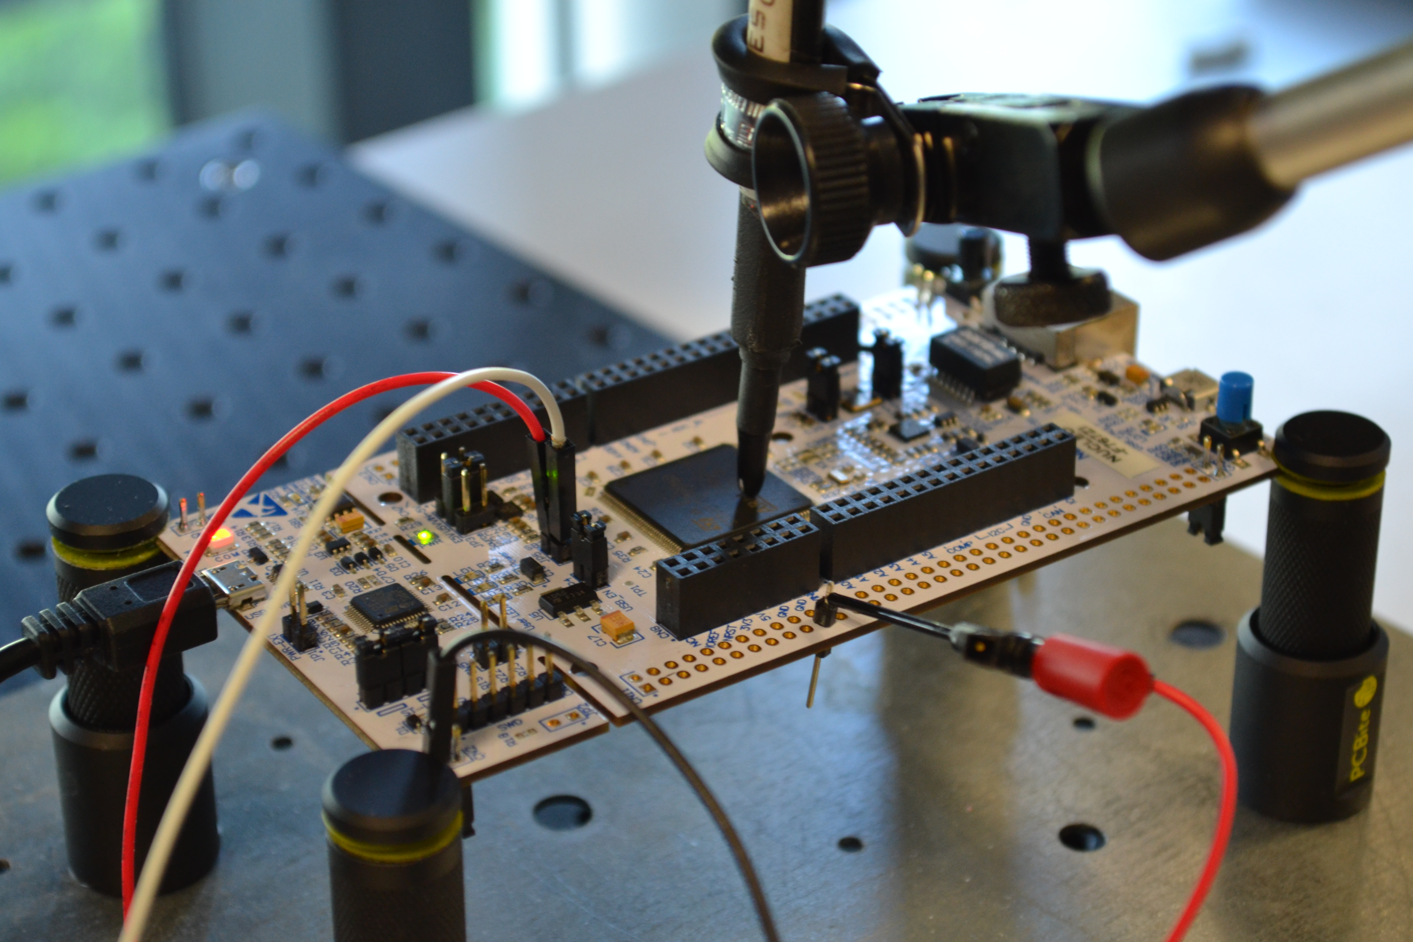
Evasion attack
  Device: ARM Cortex-M7 MCU on a STM32F767 board (216 MHz)
  Embedded AI: a 8-bit quantized denseNET (weights, activations, inputs) with NNOM* tool
  Classification problem: 10 classes (MNIST)
  Channel: Electromagnetic signal (EMV-Technik RF-U 2,5 probe)
* GitHub - majianjia/nnom: A higher-level Neural Network library for microcontrollers.

Slide 7


Evasion attack
It’s a 0
It’s a 1
It’s a 2
It’s a 3
It’s a 4
Neural network
Softmax
It’s a 5
It’s a 6
It’s a 7
It’s a 8
It’s a 9
Logits
Probability

Slide 8
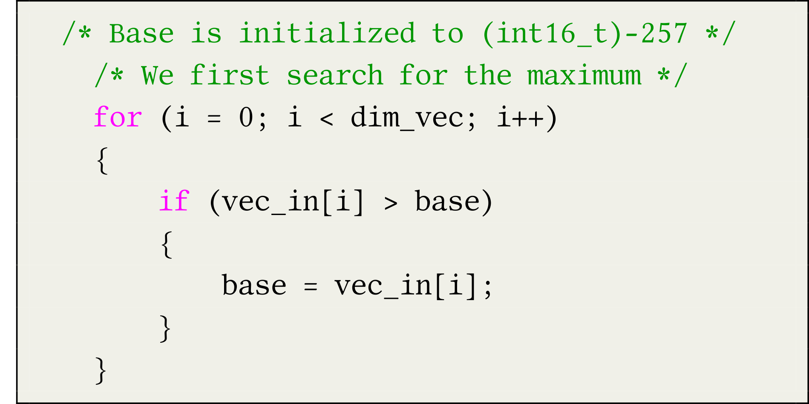














Evasion attack
  Targeted function: Softmax function
C code related to the softmax function
vec_in
$$l_{0}$$
$$l_{1}$$
$$l_{2}$$
$$l_{3}$$
$$l_{4}$$
$$l_{5}$$
$$l_{6}$$
$$l_{7}$$
$$l_{8}$$
$$l_{9}$$
$$base=0$$
$$base=l_{0}$$
$$base=l_{7}$$
$$base=l_{4}$$

Slide 9





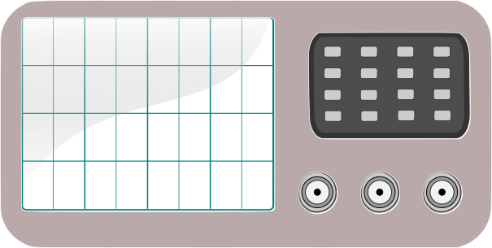
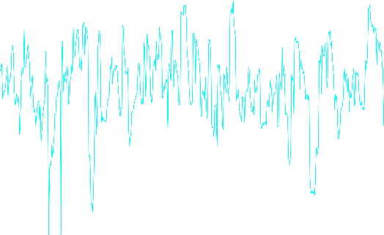
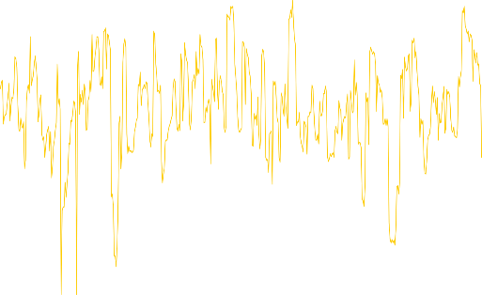


Evasion attack
  Side-Channel attacks

Slide 10

Evasion attack
  Experimental results
  Template
  Logistic regression
Deep learning
K-means
Logits
We successfully extract all the logits within 5 traces

Slide 11
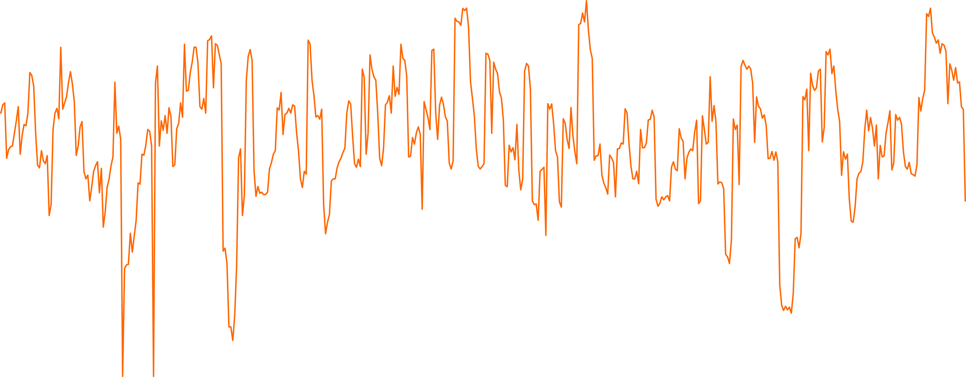
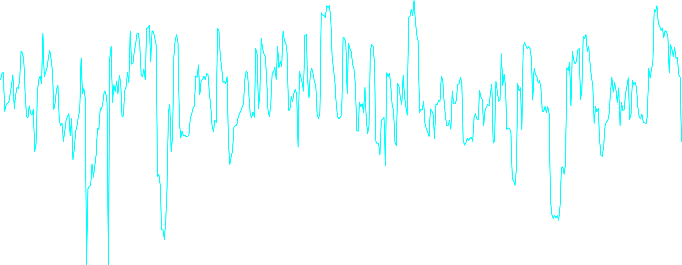


Evasion attack
  Practical issue: How can we generate adversarial examples without any knowledge on the device?
  Our idea :
  1) Extraction of the logits through the use of side-channel attacks
  2) Use the state-of-the art adversarial attacks (e.g. ZOO*)
It’s a 7 !
x3
Logits
* ‘‘ZOO: Zeroth Order Optimization Based Black-box Attacks to Deep Neural Networks without Training Substitute Models’’, Chen et al., AISec '17

Slide 12



Evasion attack
  Generate an adversarial example
    Application of the Zeroth Order Optimization* (ZOO) method
  Recap (ZOO)
  Let $X∈ℝ^{n}$ be an image and a wrong targeted class that an attacker wants to predict $y^{∗}∈𝒴$, she looks for an adversarial example $X^{∗}∈ℝ^{n}$ such that the following relation is satisfied:
  $${\left\|X^{∗}−X\right\|}_{2}^{2}+c×g_{obj}\left(X^{∗},y^{∗}\right),$$
  with $g_{obj}\left(X^{∗},y^{∗}\right)=\max\left(\max_{y≠y^{∗}}\left(\log\left(F\left(X^{∗}\right)\right)\right)\left[i\right]−\log\left(F\left(X^{∗}\right)\right)\left[y^{∗}\right], 0\right)$
Original image
Adversarial example
$$y^{∗}=7$$
$$y^{∗}=3$$
* ‘‘ZOO: Zeroth Order Optimization Based Black-box Attacks to Deep Neural Networks without Training Substitute Models’’, Chen et al., AISec '17

Slide 13

Evasion attack
  Practical issue: How can we generate adversarial examples without any knowledge on the device?
  Our idea :
  1) Extraction of the logits through the use of side-channel attacks
  2) Use the state-of-the art adversarial attacks (e.g. ZOO*)
It’s a 3 !
$$ZOO( + )$$
* ‘‘ZOO: Zeroth Order Optimization Based Black-box Attacks to Deep Neural Networks without Training Substitute Models’’, Chen et al., AISec '17

Slide 14
Physical Attacks against Neural Networks
(in this talk)
Evasion attacks
Fidelity-based extraction attack
‘‘When Side-Channel Attacks Break the Black-Box Property of Embedded Artificial Intelligence.’’, Coqueret et al., AISec ‘23

Slide 15
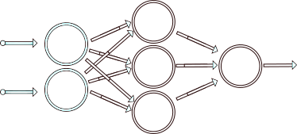
Fidelity-based extraction attack
Example “model extraction attack”
  Goal: Stealing IP of a model AND the performance of a model
    Better than accuracy-based extraction attack if we want to transfer attack (e.g. adversarial examples)
$$X_{1}$$
$$X_{1}$$
$$Y$$
$$Y$$
$$X_{2}$$
$$X_{2}$$
Hypotheses (ReLU activation function + knowledge of the architecture)
$$ReLU\left(x\right)=\max{(0,x)}$$
with $x$ a linear combination of $X_{1}$ et $X_{2}$
  ‘‘High accuracy and high fidelity extraction of neural networks’’, Jagielski et al. Usenix Security 20
  ‘‘Reverse-engineering deep ReLU networks’’, Rolnick et al. ICML 2020
  ‘‘Cryptanalytic extraction of neural network models’’, Carlini et al. Crypto 2020

Slide 16
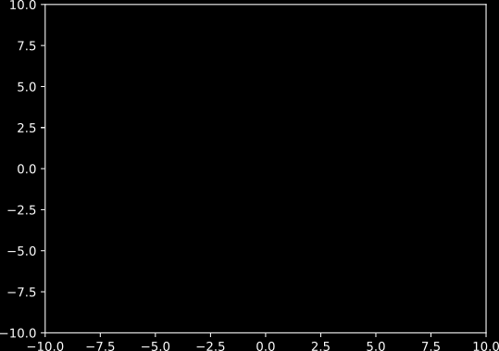

Fidelity-based extraction attack
Example “model extraction attack”
  Goal: Stealing IP of a model AND the performance of a model
$$X_{1}$$
$$Y$$
$$X_{2}$$
$$X_{2}$$
$$Y=w_{1}^{1}⋅\max\left(0,w_{0,1}^{0}X_{1}+w_{0,2}^{0}X_{2}+b_{0}\right)$$
$$+w_{2}^{1}⋅\max\left(0,w_{1,1}^{0}X_{1}+w_{1,2}^{0}X_{2}+b_{1}\right)$$
$$+w_{3}^{1}⋅max⁡(0,w_{2,1}^{0}X_{1}+w_{2,2}^{0}X_{2}+b_{2})$$
Neurons are activated/deactivated depending on $X_{1}$ and $X_{2}$ → 8 possible linear combinations
$$X_{1}$$
  ‘‘High accuracy and high fidelity extraction of neural networks’’, Jagielski et al. Usenix Security 20
  ‘‘Reverse-engineering deep ReLU networks’’, Rolnick et al. ICML 2020
  ‘‘Cryptanalytic extraction of neural network models’’, Carlini et al. Crypto 2020

Slide 17
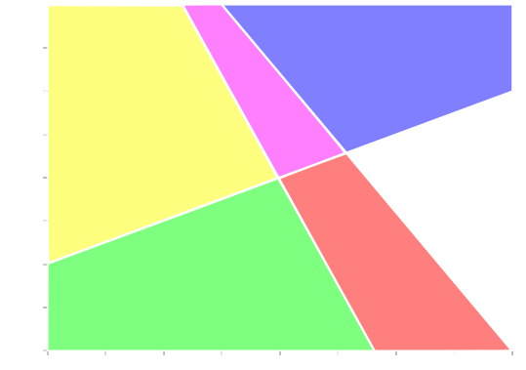
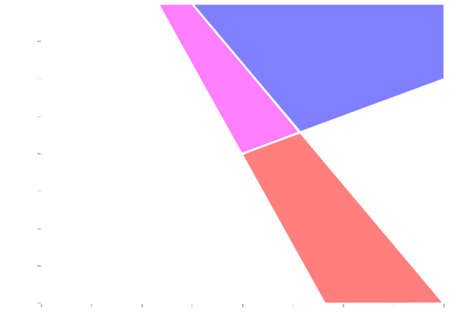



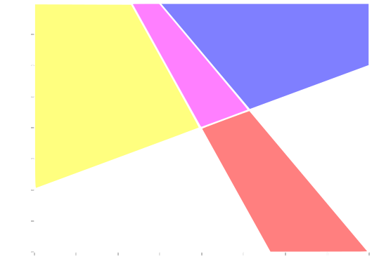
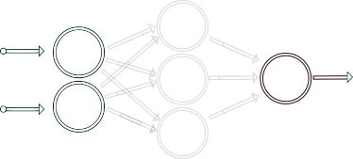
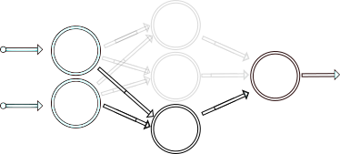
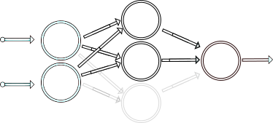
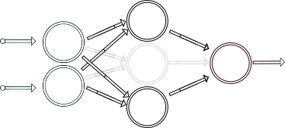

Fidelity-based extraction attack
Example “model extraction attack”
  Goal: Stealing IP of a model AND the performance of a model
$$X_{1}$$
$$Y$$
$$X_{2}$$
$$X_{2}$$
$$Y=w_{1}^{1}⋅\max\left(0,w_{0,1}^{0}X_{1}+w_{0,2}^{0}X_{2}+b_{0}\right)$$
$$+w_{2}^{1}⋅\max\left(0,w_{1,1}^{0}X_{1}+w_{1,2}^{0}X_{2}+b_{1}\right)$$
$$+w_{3}^{1}⋅max⁡(0,w_{2,1}^{0}X_{1}+w_{2,2}^{0}X_{2}+b_{2})$$
Neurons are activated/deactivated depending on $X_{1}$ and $X_{2}$ → 8 possible linear combinations
$$X_{1}$$
  ‘‘High accuracy and high fidelity extraction of neural networks’’, Jagielski et al. Usenix Security 20
  ‘‘Reverse-engineering deep ReLU networks’’, Rolnick et al. ICML 2020
  ‘‘Cryptanalytic extraction of neural network models’’, Carlini et al. Crypto 2020

Slide 18
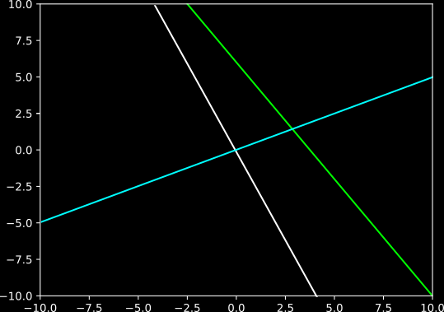

Fidelity-based extraction attack
Example “model extraction attack”
  Goal: Stealing IP of a model AND the performance of a model
$$X_{1}$$
$$Y$$
$$X_{2}$$
$$0$$
$$0=w_{2,1}^{0}X_{1}+w_{2,2}^{0}X_{2}+b_{2}$$
$$X_{2}$$
$$Y=w_{1}^{1}⋅\max\left(0,w_{0,1}^{0}X_{1}+w_{0,2}^{0}X_{2}+b_{0}\right)$$
$$+w_{2}^{1}⋅\max\left(0,w_{1,1}^{0}X_{1}+w_{1,2}^{0}X_{2}+b_{1}\right)$$
$$+w_{3}^{1}⋅max⁡(0,w_{2,1}^{0}X_{1}+w_{2,2}^{0}X_{2}+b_{2})$$
$$w_{2,1}^{0}X_{1}+w_{2,2}^{0}X_{2}+b_{2}$$
$$X_{2}=−\frac{w_{2,1}^{0}}{w_{2,2}^{0}}X_{1}−\frac{b_{2}}{w_{2,2}^{0}}$$
$$X_{1}$$
  ‘‘High accuracy and high fidelity extraction of neural networks’’, Jagielski et al. Usenix Security 20
  ‘‘Reverse-engineering deep ReLU networks’’, Rolnick et al. ICML 2020
  ‘‘Cryptanalytic extraction of neural network models’’, Carlini et al. Crypto 2020

Slide 19
Using side-channel attacks to extract the critical points
(Attack overview)

Slide 20










Fidelity-based extraction attack
Example “model extraction attack”
  Goal: Stealing IP of a model AND the performance of a model
$$X_{1}$$
$$Y$$
$$X_{2}$$
$$P_{0}$$
$$P_{2}$$
Algorithm
  1) Draw 2 points $\left(P_{0},P_{1}\right)$ and capture the physical signal $T(P_{0})$ and $T(P_{1})$
$$P$$
$$P_{1}$$
$$w_{0,1}^{0}X_{1}+w_{0,2}^{0}X_{2}+b_{0}$$
$$X_{2}$$
  2) From $T(P_{0})$ and $T(P_{1})$, use SCA to identify if $\left(P_{0},P_{1}\right)$ are in the same state
$$0$$
  3) If $state\left(P_{0}\right)==state\left(P_{1}\right)$, goto (1), else draw a point $P_{2}=\frac{\left(P_{0}+P_{1}\right)}{2}$ and capture the physical signal $T\left(P_{2}\right)$
  4) From $T(P_{2})$, $T\left(P_{1}\right)$ and $T(P_{0})$, use SCA to identify if $\left(P_{0}, P_{2}\right)$ or $\left(P_{1}, P_{2}\right)$ are in the same state
$$X_{1}$$
  5) For $\left(P_{i}, P_{2}\right)$ that are not in the same state, draw a point $P_{3}=\frac{\left(P_{2}+P_{i}\right)}{2}$
  6) …

Slide 21



Fidelity-based extraction attack
Example “model extraction attack”
  Goal: Stealing IP of a model AND the performance of a model
$$X_{1}$$
$$Y$$
$$X_{2}$$
$$X_{2}=−\frac{w_{0,1}^{0}}{w_{0,2}^{0}}X_{1}−\frac{b_{0}}{w_{0,2}^{0}}$$
$$X_{2}=−\frac{w_{1,1}^{0}}{w_{1,2}^{0}}X_{1}−\frac{b_{1}}{w_{1,2}^{0}}$$
$$X_{2}$$
$$X_{2}$$
$$X_{2}=−\frac{w_{2,1}^{0}}{w_{2,2}^{0}}X_{1}−\frac{b_{2}}{w_{2,2}^{0}}$$
$$X_{1}$$
$$X_{1}$$
Compute least-squares solution to equation $AX_{1}+b=X_{2}$

Slide 22
Using side-channel attacks to extract the critical points
(SCA Vulnerability)

Slide 23
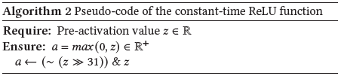
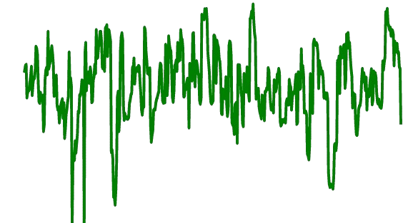


Fidelity-based extraction attack
Example “model extraction attack”
  Goal: Stealing IP of a model AND the performance of a model
$$X_{1}$$
$$Y$$
$$X_{2}$$
Algorithm
  1) Draw 2 points $\left(P_{0},P_{1}\right)$ and capture the physical signal $T(P_{0})$ and $T(P_{1})$
$$w_{0,1}^{0}X_{1}+w_{0,2}^{0}X_{2}+b_{0}$$
$$X_{2}$$
$$0$$
If $z<0$
If $z≥0$
0x00000000
0xFFFFFFFF
$$X_{1}$$

Slide 24
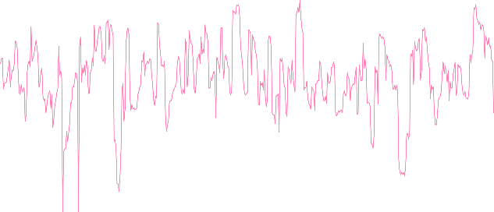





Fidelity-based extraction attack
Example “model extraction attack”
  Goal: Stealing IP of a model AND the performance of a model
$$X_{1}$$
$$Y$$
$$X_{2}$$
$$P_{0}$$
Algorithm
  1) Draw 2 points $\left(P_{0},P_{1}\right)$ and capture the physical signal $T(P_{0})$ and $T(P_{1})$
$$P_{1}$$
$$w_{0,1}^{0}X_{1}+w_{0,2}^{0}X_{2}+b_{0}$$
$$X_{2}$$
$$0$$
$T(P_{0})$
$T(P_{1})$
  2) From $T(P_{0})$ and $T(P_{1})$, use SCA to identify if $\left(P_{0},P_{1}\right)$ are in the same state
$$X_{1}$$
K-means

Slide 25

Fidelity-based extraction attack
Example “model extraction attack”
  Goal: Stealing IP of a model AND the performance of a model
$$X_{1}$$
$$Y$$
$$X_{2}$$
Algorithm
  1) Draw 2 points $\left(P_{0},P_{1}\right)$ and capture the physical signal $T(P_{0})$ and $T(P_{1})$
$$X_{2}$$
  2) From $T(P_{0})$ and $T(P_{1})$, use SCA to identify if $\left(P_{0},P_{1}\right)$ are in the same state
  3) If $state\left(P_{0}\right)==state\left(P_{1}\right)$, goto (1), else draw a point $P_{2}=\frac{\left(P_{0}+P_{1}\right)}{2}$ and capture the physical signal $T\left(P_{2}\right)$
  4) From $T(P_{2})$, $T\left(P_{1}\right)$ and $T(P_{0})$, use SCA to identify if $\left(P_{0}, P_{2}\right)$ or $\left(P_{1}, P_{2}\right)$ are in the same state
$$X_{1}$$
  5) For $\left(P_{i}, P_{2}\right)$ that are not in the same state, draw a point $P_{3}=\frac{\left(P_{2}+P_{i}\right)}{2}$
Final Step: Compute least-squares solution to equation $AX_{1}+b=X_{2}$
  6) …

Slide 26
Fidelity-based extraction attack
  Device: ARM Cortex-M7 MCU on a STM32F767 board (216 MHz)
  Embedded AI: a 32-bit neural networks implemented with X-Cube-AI* tool
  Problem: Regression and Classification tasks
  Channel: Electromagnetic signal (EMV-Technik RF-U 2,5 probe)
Type of architectures | Nb of parameters | Nb of targets
Small MLP | < 200,000 | 7
MLP | 935,370 | 1
Large MLP | 1,721,802 | 1
MobileNetv1-short | 5,234 | 1
* X-CUBE-AI - AI expansion pack for STM32CubeMX - STMicroelectronics

Slide 27
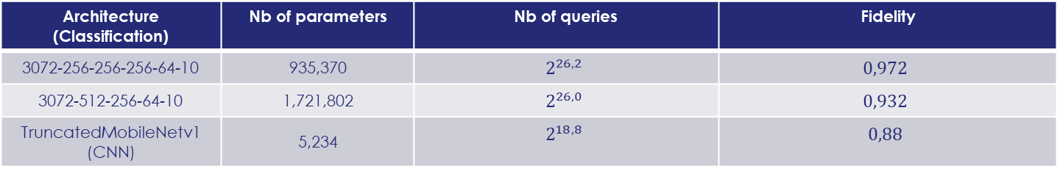

Fidelity-based extraction attack
(for classification task)
  How assessing the efficiency of fidelity-based extraction attacks (for classification task)?
  1) Number of queries required to extract all the neurons
  2) Fidelity metric = $Pr⁡\left[\underset{𝒴}{argmax}{f\left(X\right)}=\underset{𝒴}{argmax}{\hat{f}\left(X\right)}\right]$ s.t. $f\left(.\right)$ (resp. $\hat{f}(.)$) is the targeted model (resp. the copy)
  3) Weight difference = $\max_{i,j,k} {\left\|w_{j,k}^{i} −{\hat{w}}_{j,k}^{i}\right\|}_{1}$
  New targeted architectures
Architecture (Classification) | Nb of parameters | Nb of queries | Fidelity
3072-256-256-256-64-10 | 935,370 | $$2^{26,2}$$ | $$0,972$$
3072-512-256-64-10 | 1,721,802 | $$2^{26,0}$$ | $$0,932$$
TruncatedMobileNetv1 (CNN) | 5,234 | $$2^{18,8}$$ | $$0,88$$
First extraction of CNN using cryptanalytical-based extraction attacks by taking benefits of SCA !
  ‘‘Cryptanalytic extraction of neural network models’’, Carlini et al. Crypto 2020

Slide 28
Physical Attacks against Neural Networks
(in this talk)
Evasion attacks
Fidelity-based extraction attack
‘‘When Side-Channel Attacks Break the Black-Box Property of Embedded Artificial Intelligence.’’, Coqueret et al., AISec ‘23

Slide 29
Conclusion
Combining Software & Hardware attacks is beneficial to reduce adversary’s knowledge.
Side-channel attacks can be used to prevent some issues with software attacks.
  Performing fidelity-based extraction attacks on CNN architectures.
  Mitigating the effect of special case neurons.
Extends the security threats against embedded AI system.
Needs of finding adequate countermeasures which not alter the performance of embedded AI too much.
Benoit will present his work during the SemSecuElec Seminar this Friday ☺
  https://www.creachlabs.fr/en/seminars-keeping-date-latest-research/semsecuelec-seminar/cryptanalytical-extraction-complex-neural-networks-black-box-settings

Slide 30

Merci
Contact: gabriel.zaid@thalesgroup.com

Slide 31





Fidelity-based vs. Accuracy-based extraction attack
Accuracy-based extraction: stealing the performance task ONLY
Fidelity-based extraction: stealing the performance task AND the IP of the model
Attack
Woman
Man
Accuracy-based extraction
Fidelity-based extraction
Woman
Man
Attack
Man
Woman
The fidelity-based extraction is beneficial to mount higher-level attacks against it, e.g., generation of adversarial examples in a white-box scenario

Slide 32
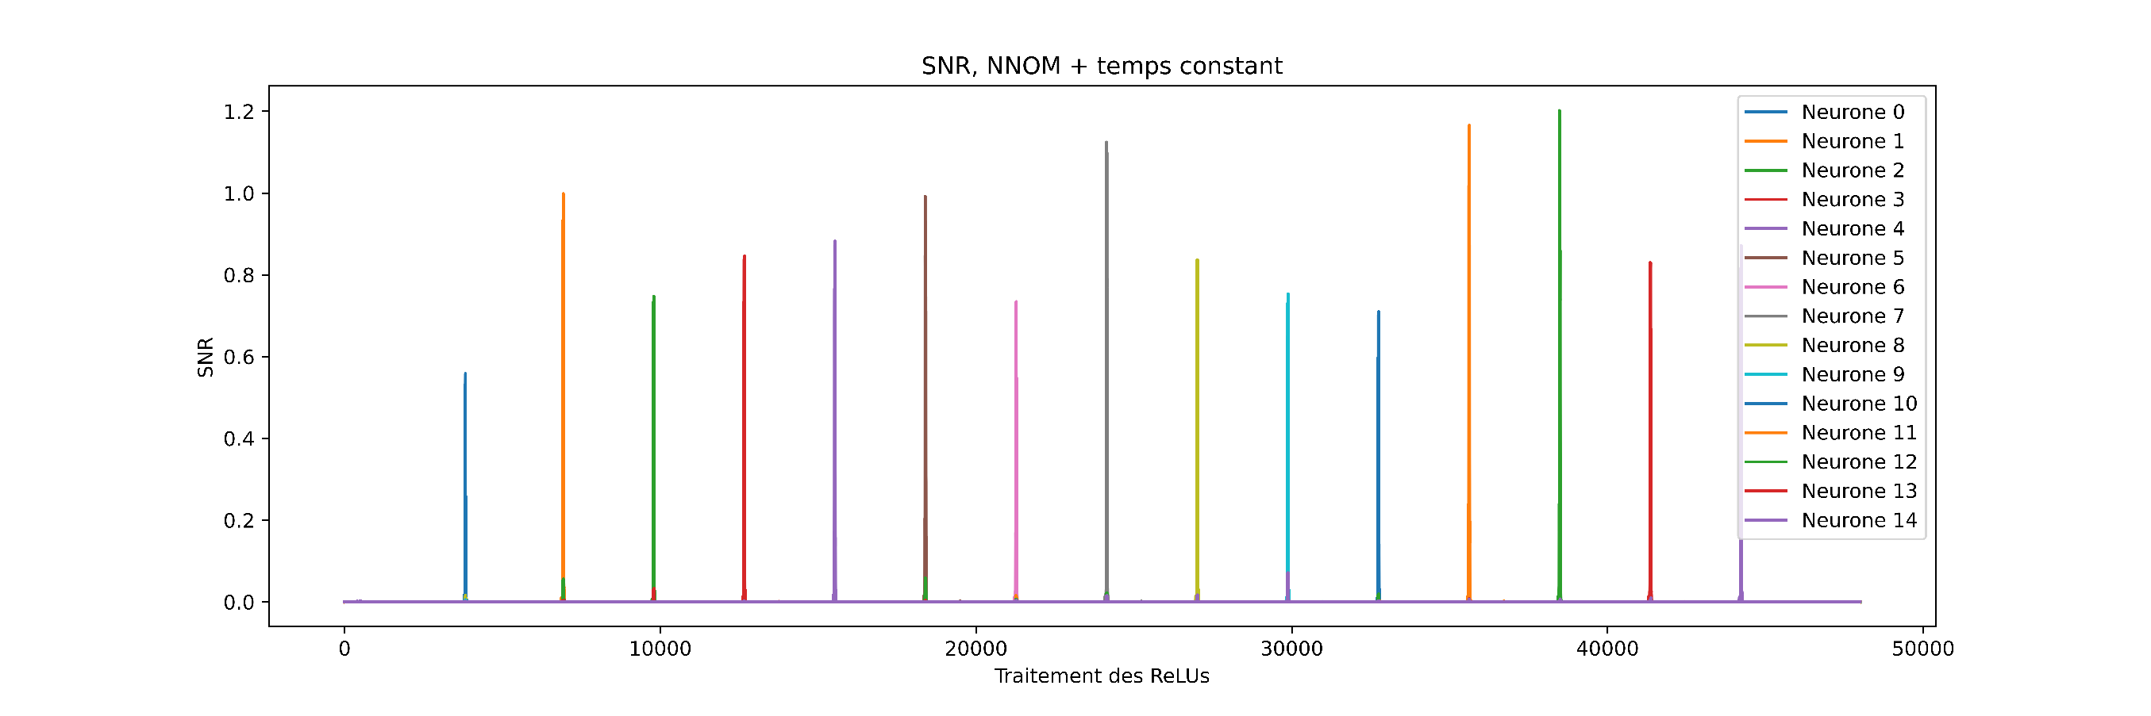
Fidelity-based extraction attack
  Example of SNR obtained on a MLP with 15 neurons
Time samples
Average Success Rate of retrieving each neuron state in 1 trace (using K-means): 86,3%

Slide 33
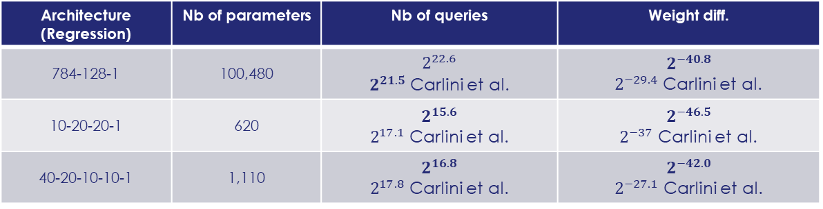
Fidelity-based extraction attack
(for regression task)
  How assessing the efficiency of fidelity-based extraction attacks (for regression task)?
  1) Number of queries required to extract all the neurons
  2) Weight difference = $\max_{i,j,k} {\left\|w_{j,k}^{i} −{\hat{w}}_{j,k}^{i}\right\|}_{1}$
  Comparison with SOTA
Architecture (Regression) | Nb of parameters | Nb of queries | Weight diff.
784-128-1 | 100,480 | $$2^{22.6}$$ $2^{21.5}$ Carlini et al. | $$2^{−40.8}$$ $2^{−29.4}$ Carlini et al.
10-20-20-1 | 620 | $$2^{15.6}$$ $2^{17.1}$ Carlini et al. | $$2^{−46.5}$$ $2^{−37}$ Carlini et al.
40-20-10-10-1 | 1,110 | $$2^{16.8}$$ $2^{17.8}$ Carlini et al. | $$2^{−42.0}$$ $2^{−27.1}$ Carlini et al.
/2
x2,700
x4
x700
x2
x32,000
  ‘‘Cryptanalytic extraction of neural network models’’, Carlini et al. Crypto 2020

